Slide 1

SOS Consultants
Alexa Bearden
Eric Chen
Patrick Warren
Brad Riggs
Cailyn Cochran

Slide 2


Today’s Agenda
Organizational Needs
Proposed Solutions
Valuations
Prototypes
Wrap-Up
Notes:
We would like to thank Dr. Robert M. Barker and the University of Louisville’s College of Business for giving us this real-world opportunity to help this local non-profit organization, who does so much good for our community and it’s people..

Slide 3
Organizational Needs
Social Media Presence
Links hard to find
Link to social media page
Language Translator
Only in English
76% visitors/patients are Spanish speakers

Slide 4
Organizational Needs cont.
Improved Donor Process
Using PayPal
Option for newsletter
Feedback
Database
Non-existent
Form data stored directly in Excel
Different files
Manual data entry

Slide 5
Solution
Social Media Presence
Links to sites will be functional
Links will display on every page
Language Translator
WordPress Plugin
Translate to Spanish
Plugins
Multi-Site Language Switcher
WordPress Language

Slide 6
Solution cont.
Improved Donor Form
Keep using PayPal
Keep recurring donation option
Create a button on every page to donate
Database
Centralized database for all forms
Run reports to create events
Donor, volunteer, staff, patient, and location information stored

Slide 7
Expected Benefits
Assuming 150 donors per year who donate at an average rate of $50.00 totaling to $7500 you can expect the following increases for year 1:
Social Media Presence
10% increase in donations = $750
Language Translator(assuming 50 Spanish speaking patients with 10 friends/family members each)
2% increase to patient’s friends and family donations = $500
Improved Donation Process
10% increase in donations = $750
Relational Database
10% increase in donations = $750
2 additional grants = $10,000
TOTAL MONETARY GAIN FOR YEAR 1: $12,750

Slide 8
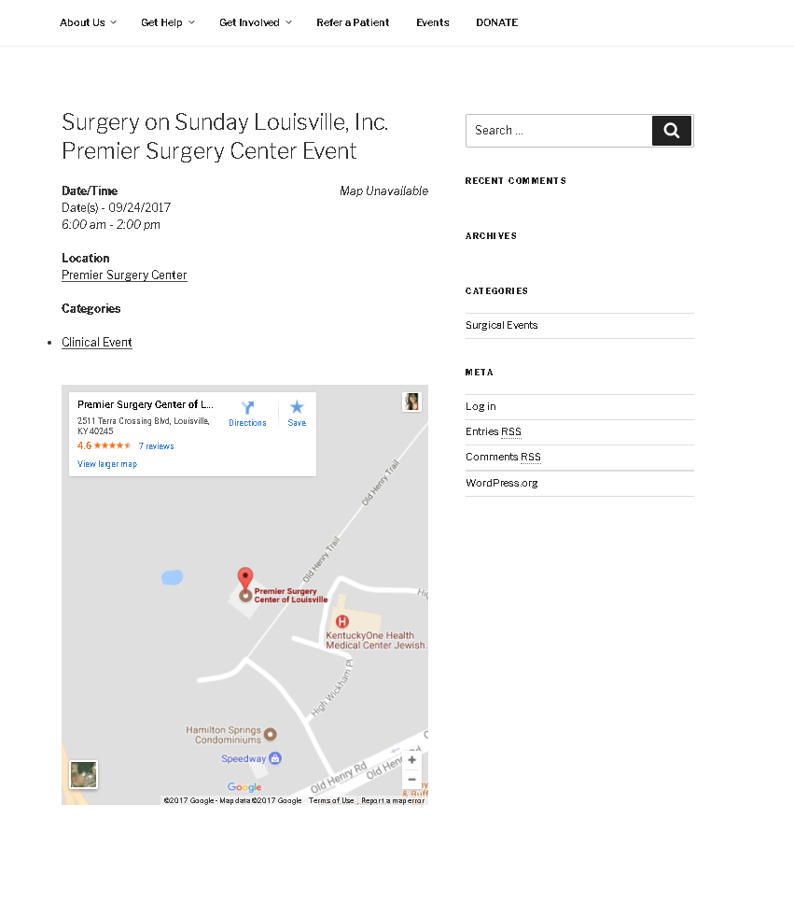
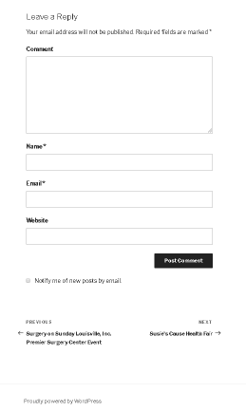
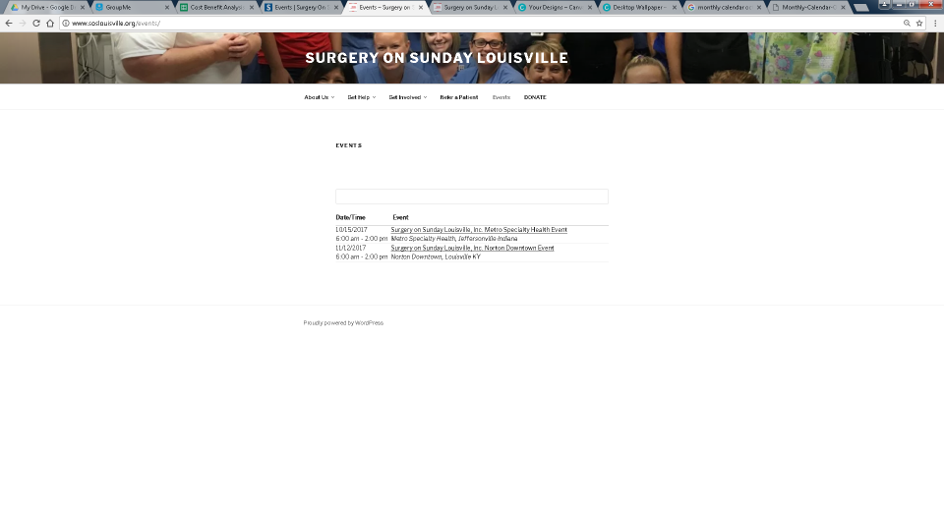
Current Site - Events

Slide 9
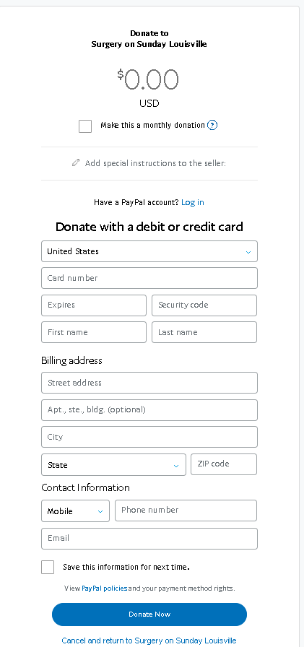
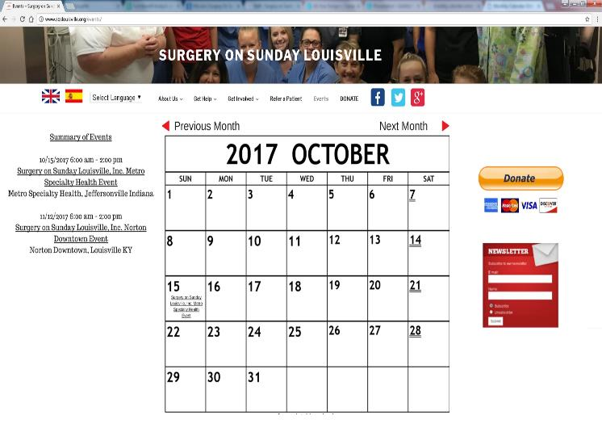
Prototype

Slide 10
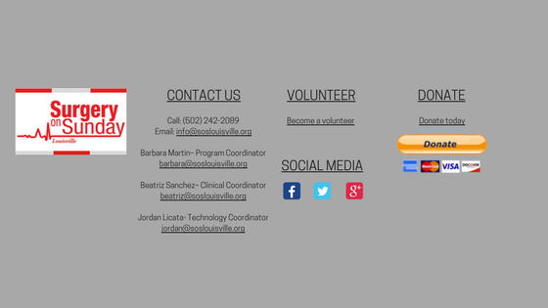
Prototype - Footer

Slide 11
Cost Benefit Analysis Summary
Based on a 5 year period
Total Benefits | 66,484
Total Costs | 7,357
Total Profit | 59,127
Return on Investment | 804%
Net Present Value | $50,565
Break-Even Point | Year 1

Slide 12
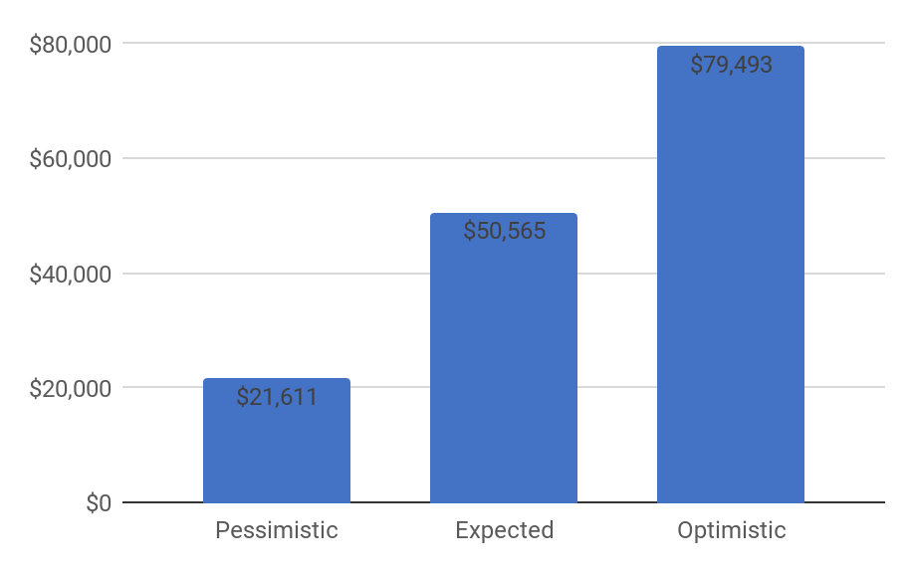
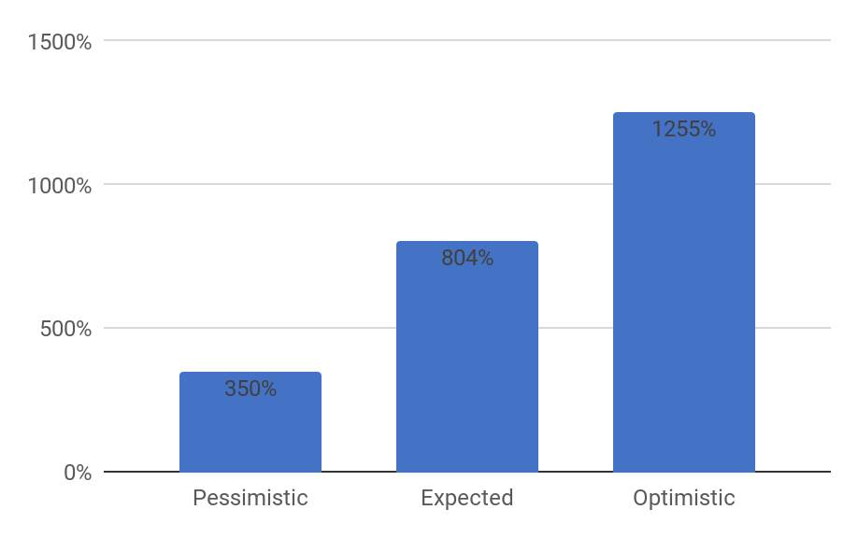
ROI
NPV

Slide 13
Thank you
Questions?

